Slide 1
2012 Graduates

Slide 2
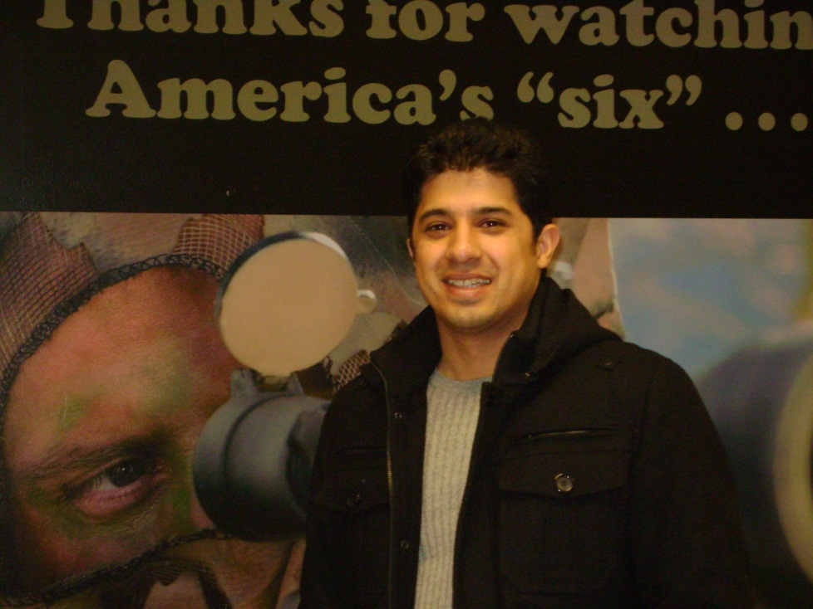
Mohammad Akram

Slide 3
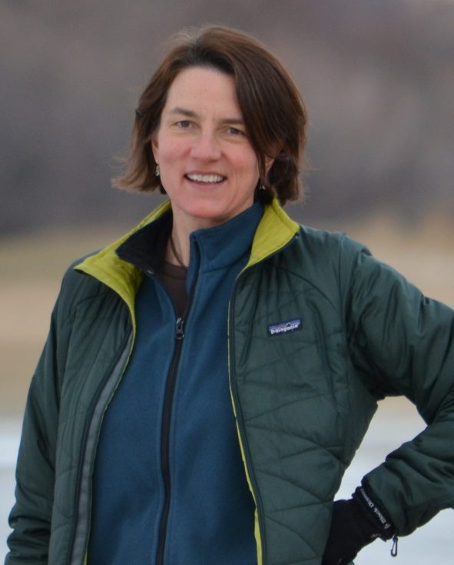
Nedra Chandler

Slide 4
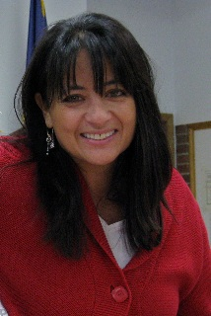
Emily Colomeda

Slide 5
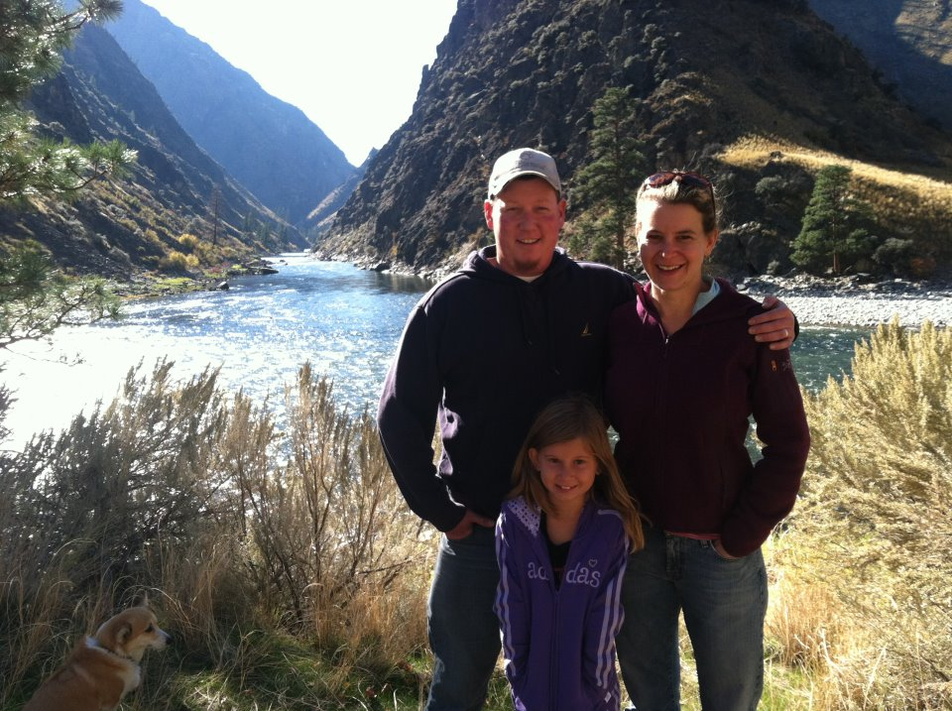
Tracy Knoedler

Slide 6
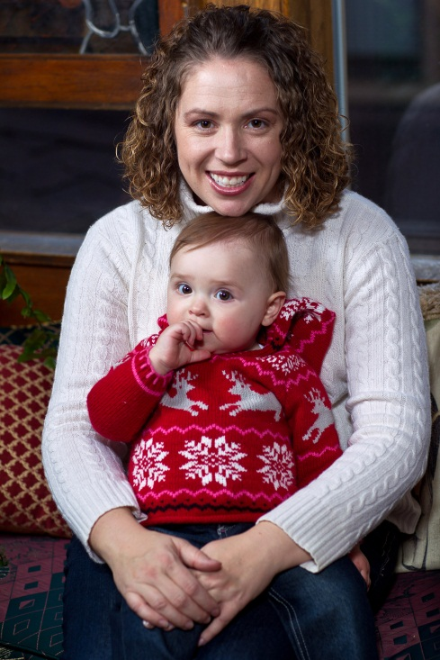
Kimberly Koch

Slide 7
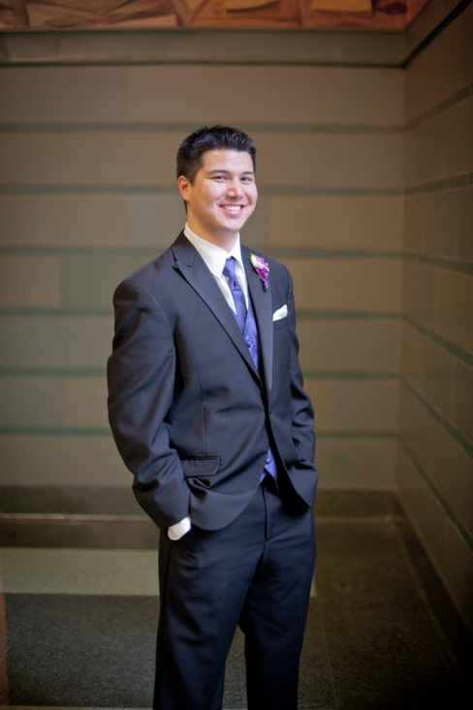
Douglas Obana

Slide 8
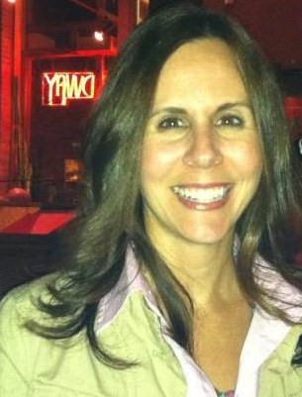
Desiree Restad

Slide 9
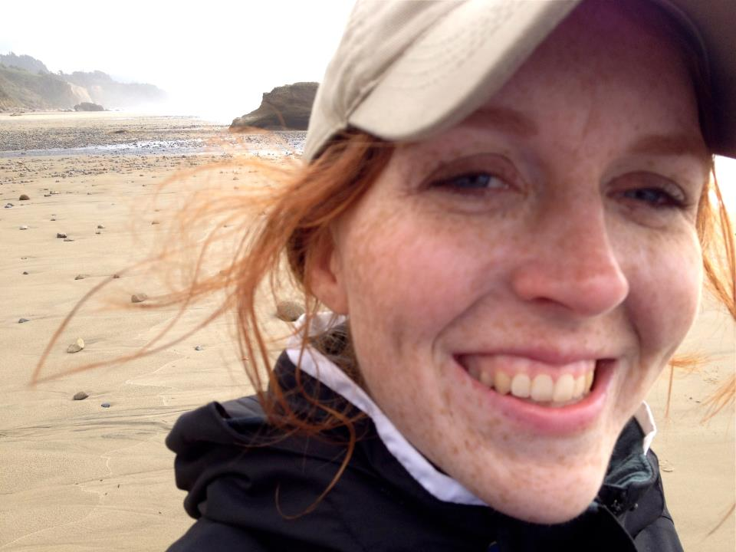
Jacqueline Semmens

Slide 10
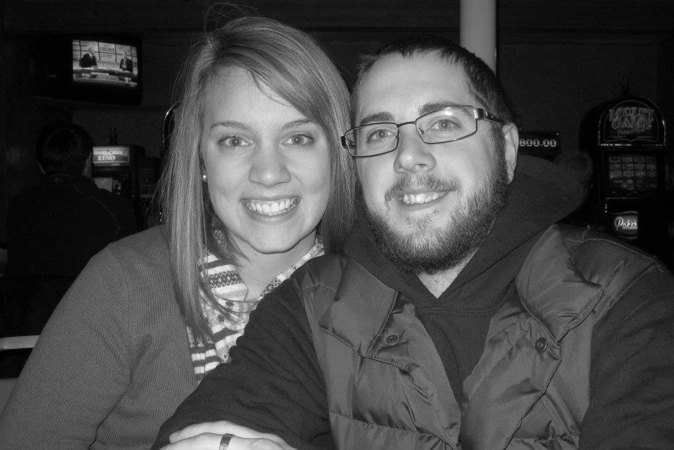
Emily williams

Slide 11
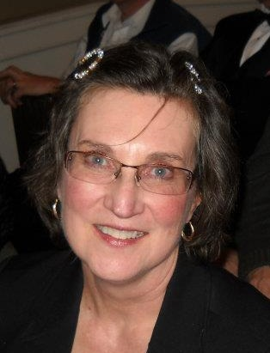
Winifred Youngblood

