Slide 1
2014 Graduates

Slide 2
Kirsten Anderson
CPH
5/17/2014

Slide 3
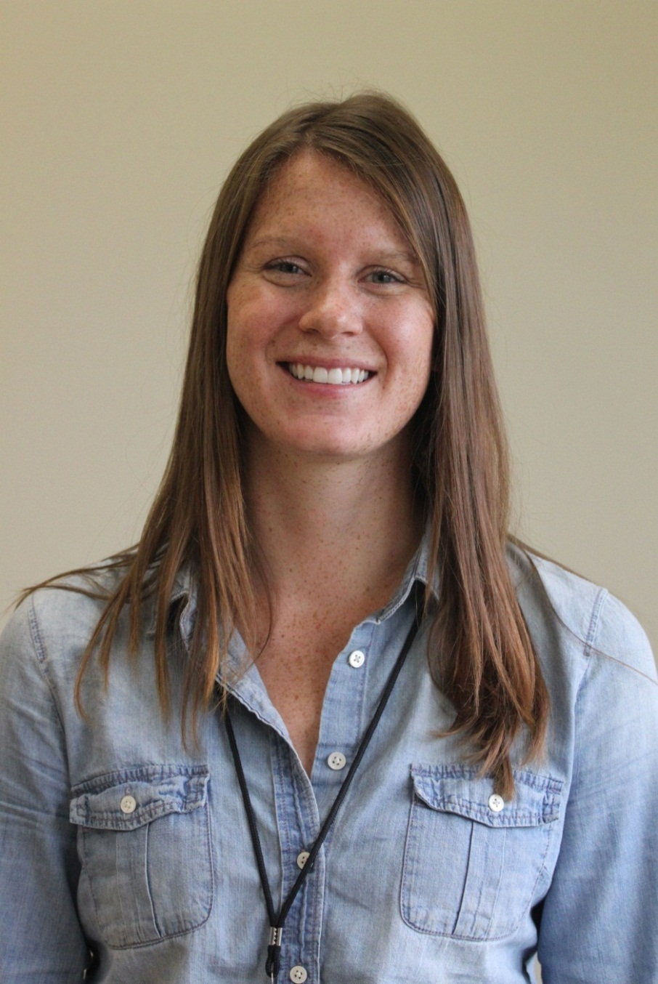
Alyssa Auvinen
CPH
5/17/2014

Slide 4
MPH
Katelin Conway
5/17/2014

Slide 5
Tyler Ellis
CPH
5/17/2014

Slide 6
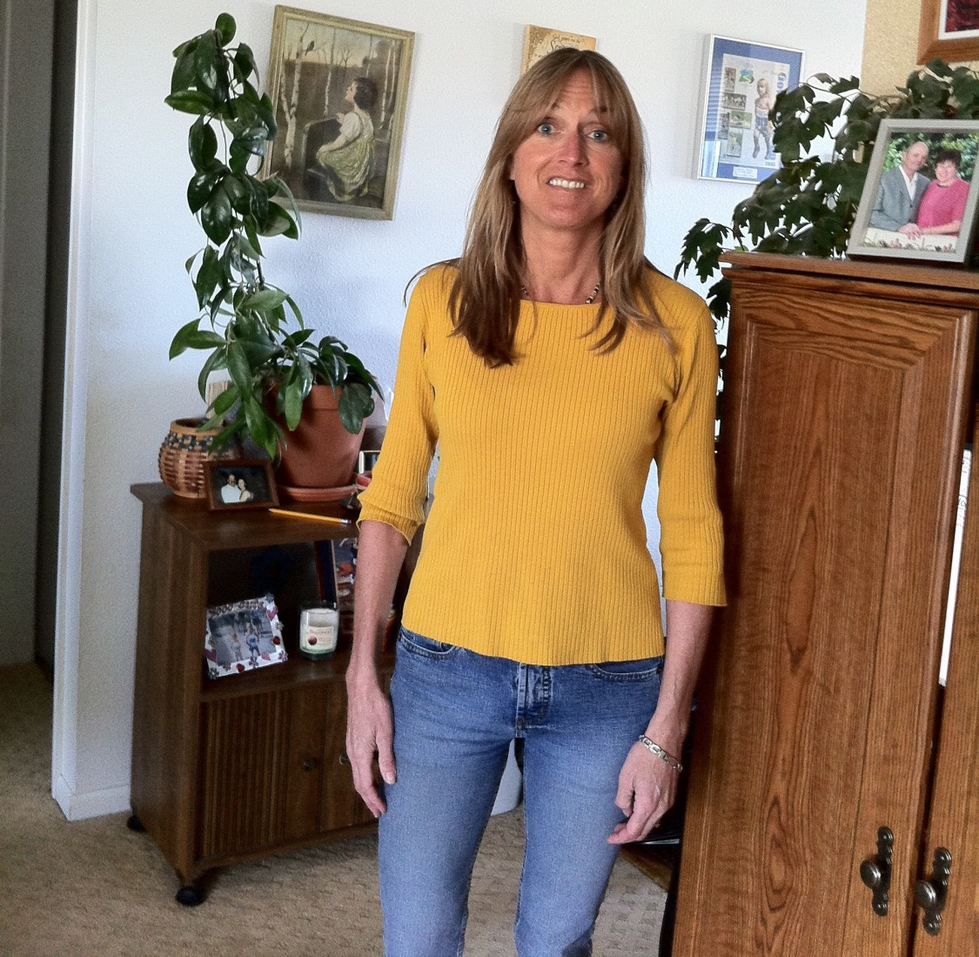
MPH
Debbie Gibson
5/17/2014

Slide 7
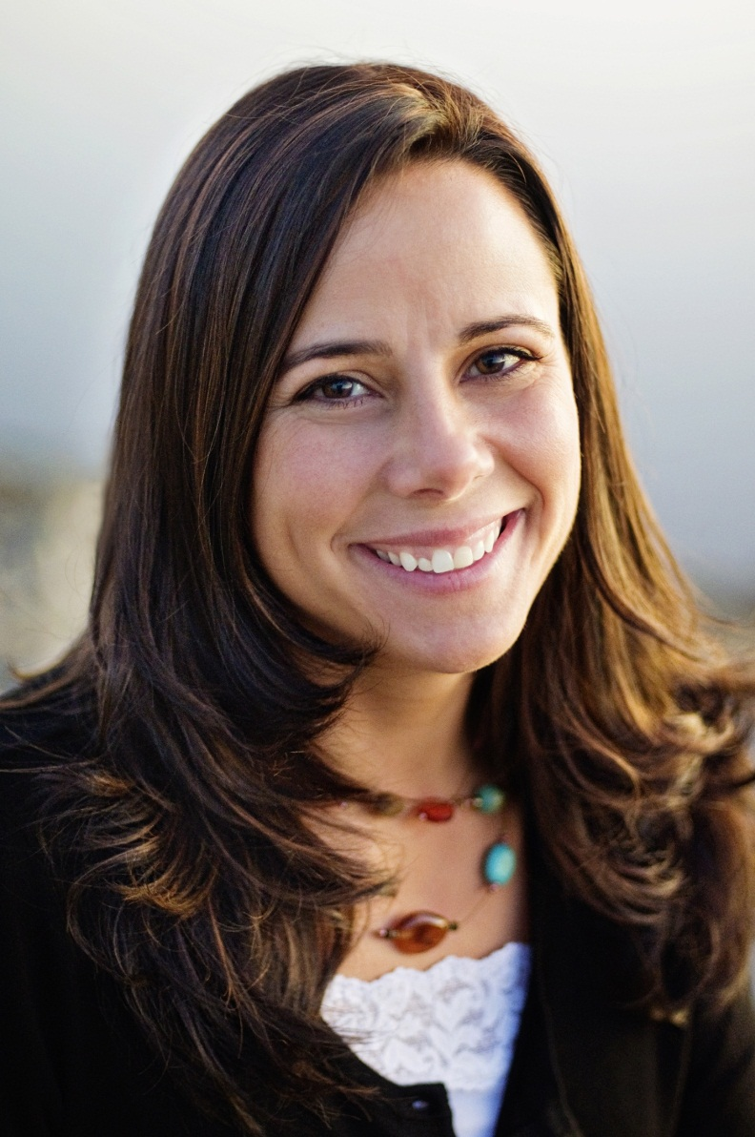
MPH
Niki Graham
5/17/2014

Slide 8
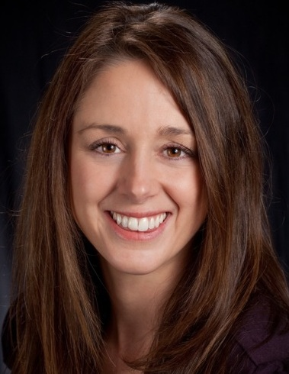
MPH
Brooke Krininger
5/17/2014

Slide 9
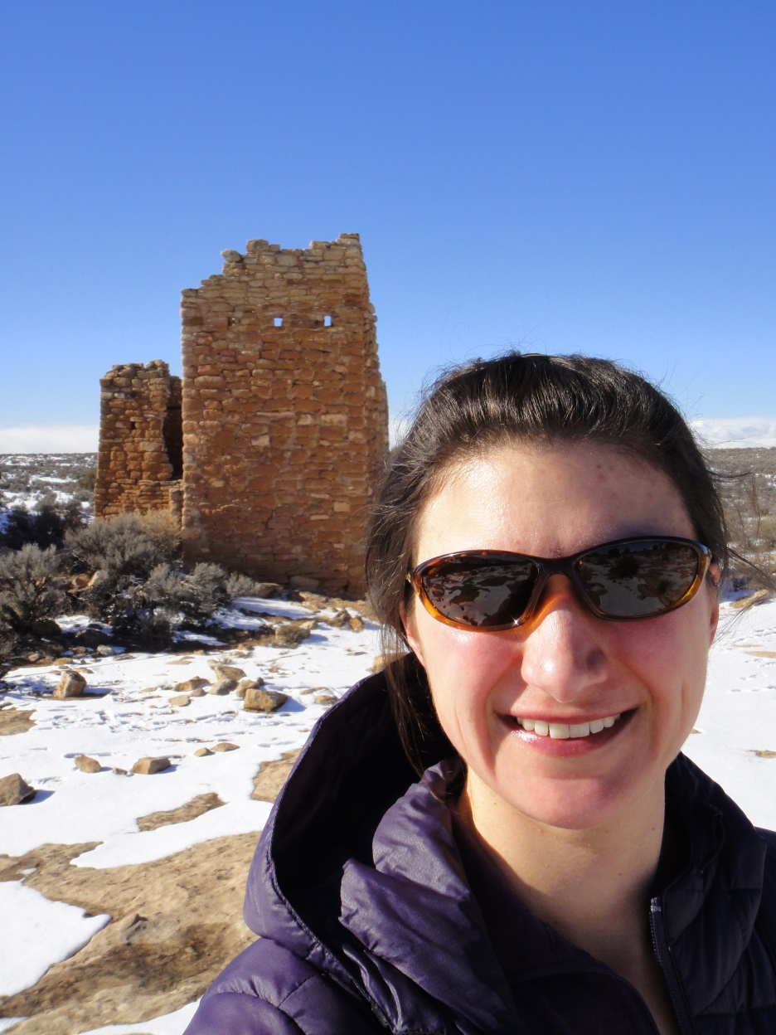
Rachel Latham
CPH
5/17/2014

Slide 10
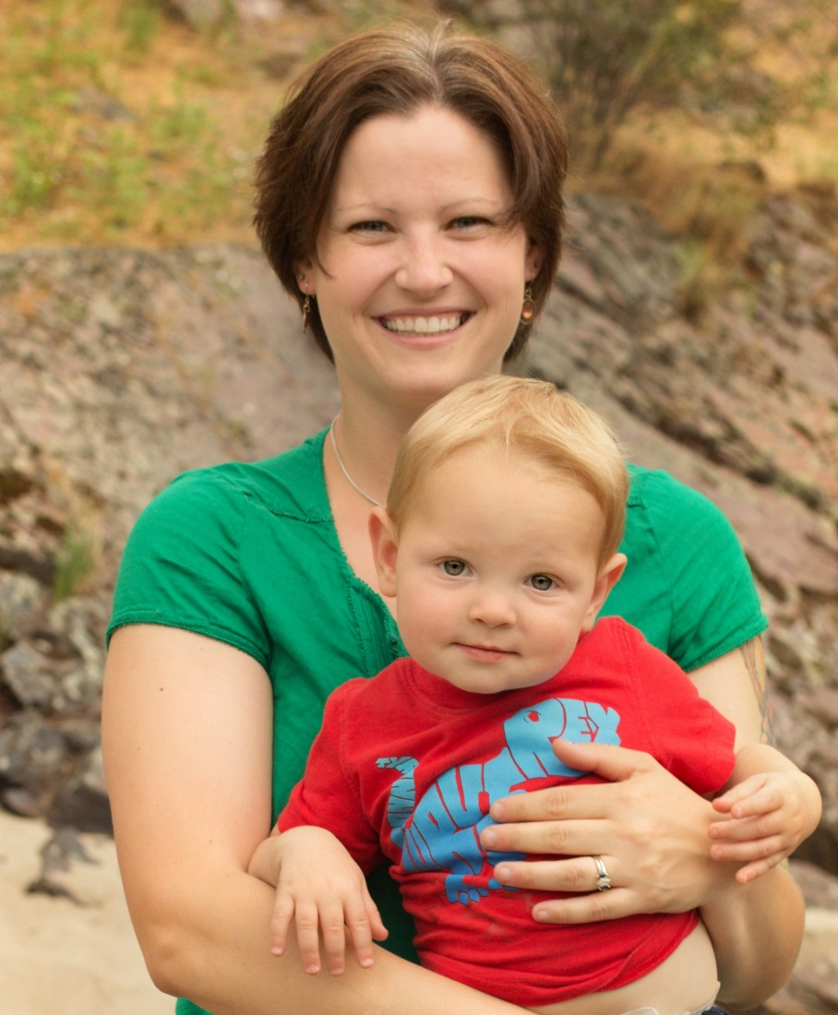
Amy Lommen
CPH
5/17/2014

Slide 11
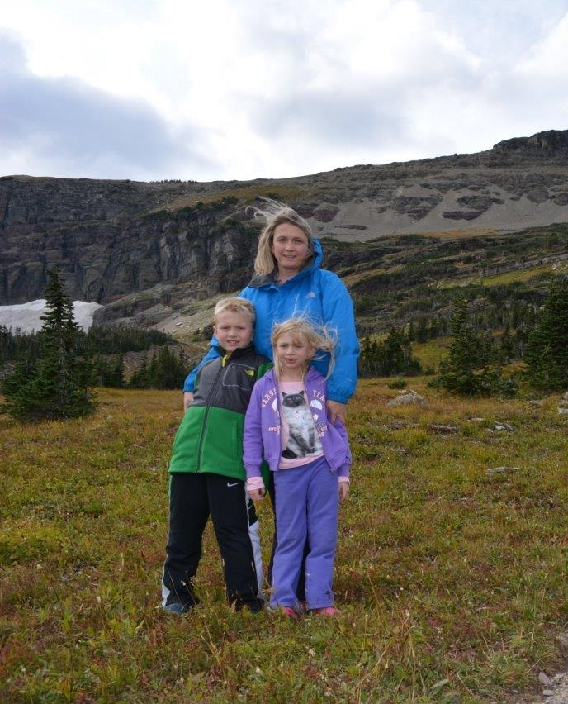
MPH
Jennifer Rankosky
5/17/2014

Slide 12
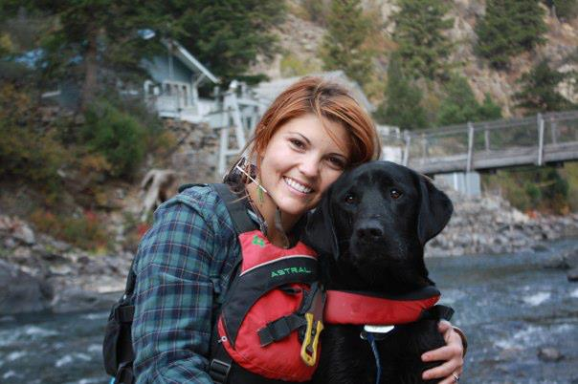
Maggie Secrest
CPH
5/17/2014

Slide 13
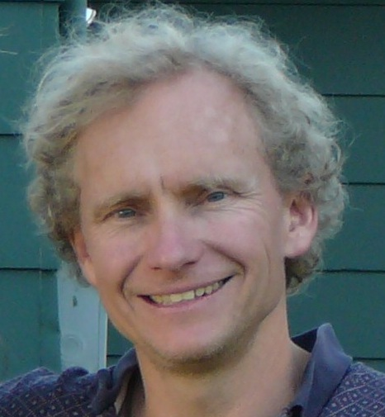
MPH
Robin Silverstein
5/17/2014

Slide 14
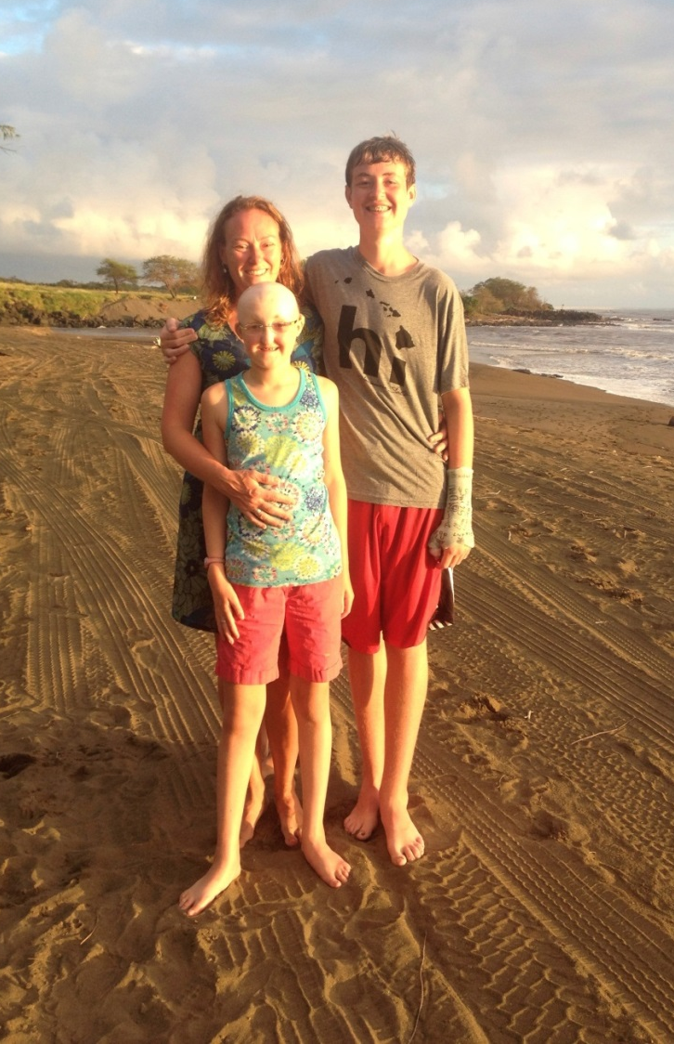
MPH
Maggie Springer
5/17/2014

Slide 15
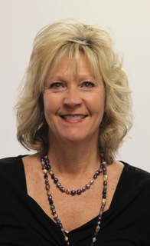
Tamalee St. James
CPH
5/17/2014

Slide 16
Linnea Stanhope
CPH
5/17/2014

Slide 17
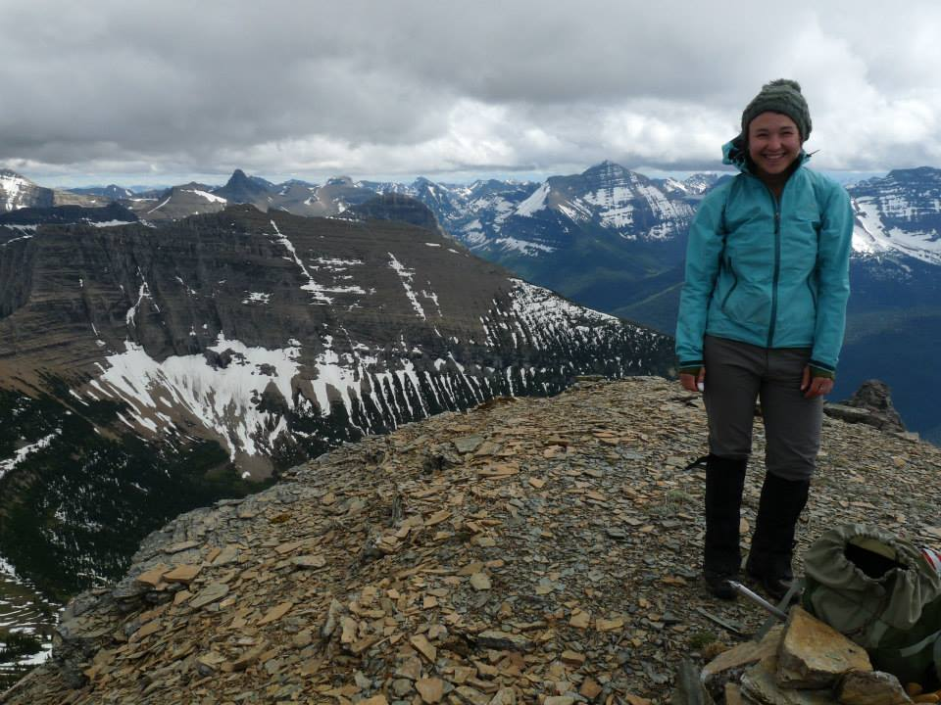
MPH
Rosemary Till
5/17/2014

Slide 18
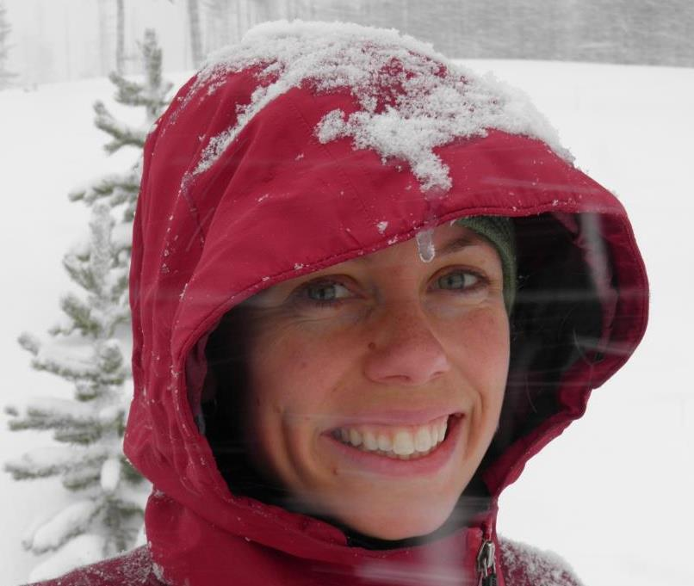
MPH
Rebecca Wade
5/17/2014

