Slide 1
School of Public and Community Health Sciences
Graduation 2016

Slide 2
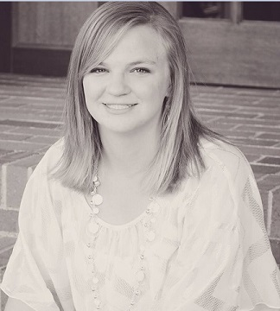
CPH
Anna
Andrechak

Slide 3
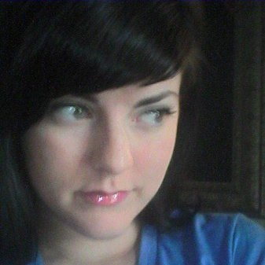
CPH
Jamie
Boschee

Slide 4
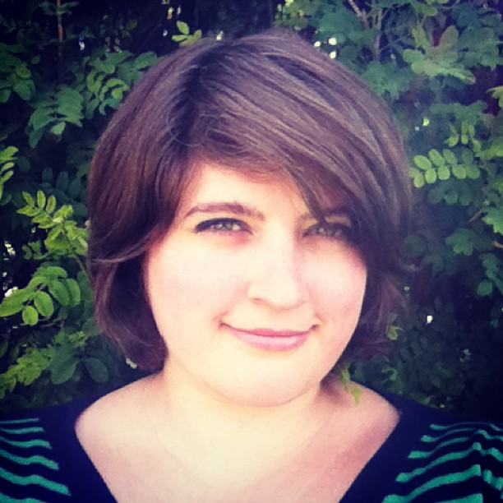
CPH
Julie
Cole
Physical Therapy

Slide 5
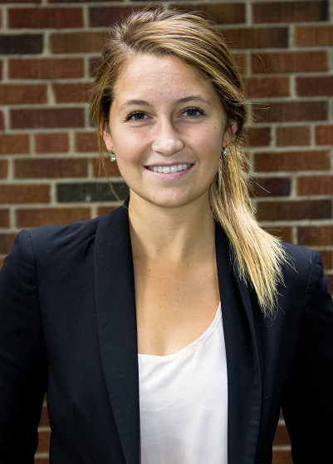
CPH
Madison
Cole
Environmental Studies

Slide 6
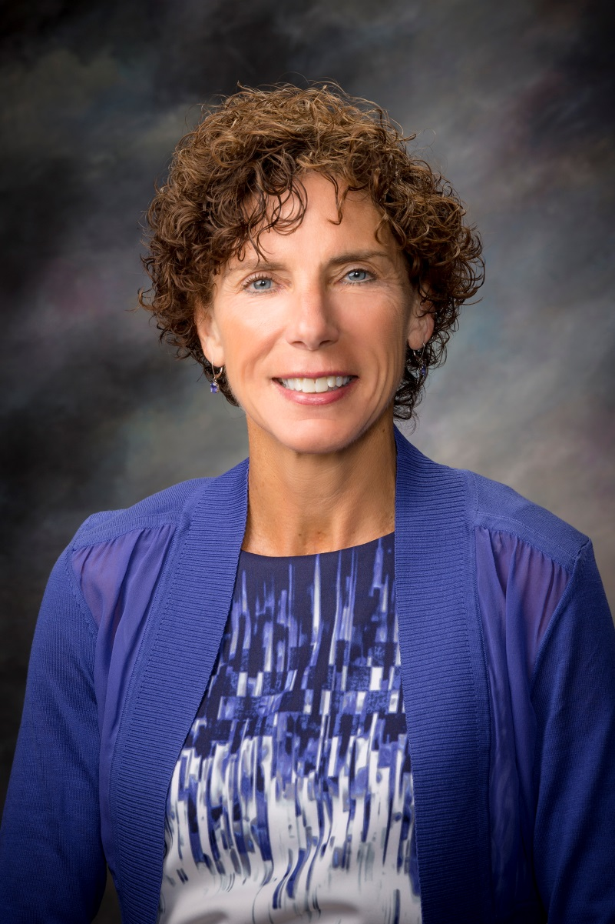
CPH
Joyce
Dombrouski

Slide 7
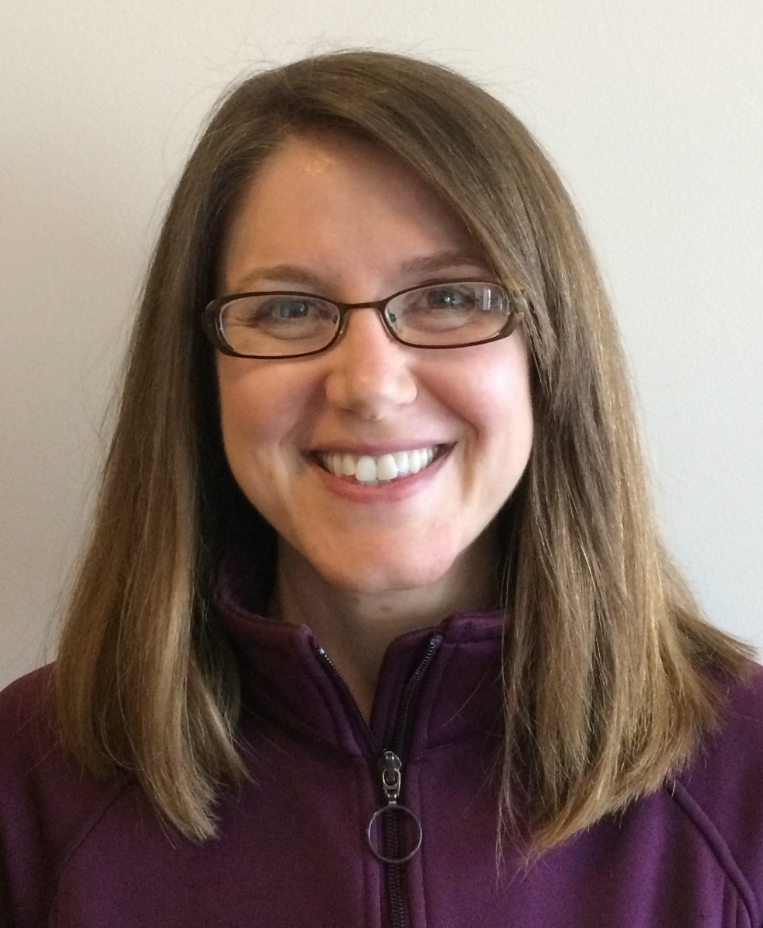
MPH
Tovah
Foss

Slide 8
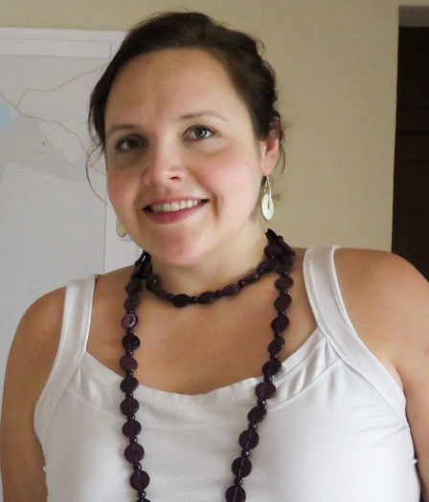
MPH
Annie
Glover

Slide 9
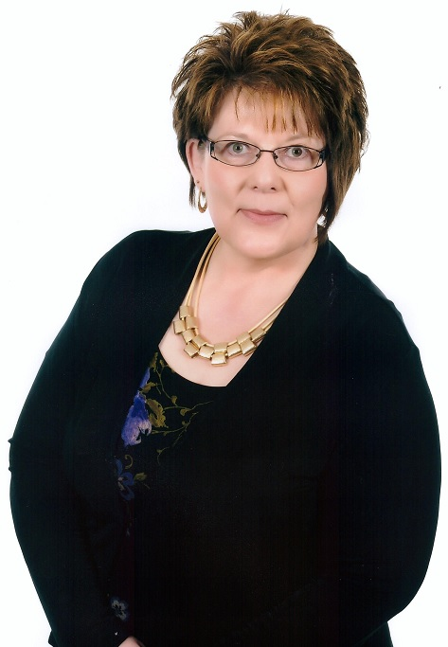
MPH
Shawn
Hinz

Slide 10
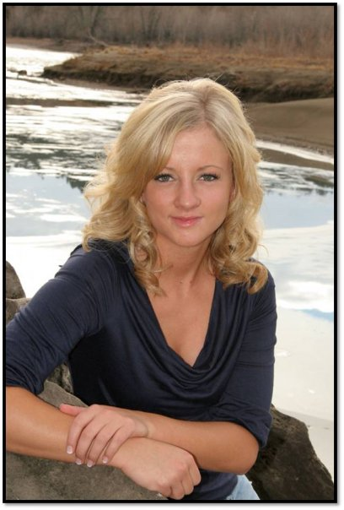
CPH
Alyssa
Hjelvik
Business Administration

Slide 11
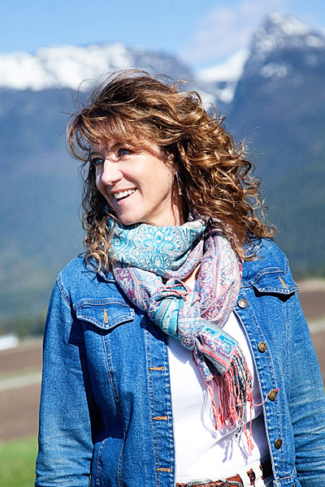
MPH
Roxanne
Hovenkotter

Slide 12
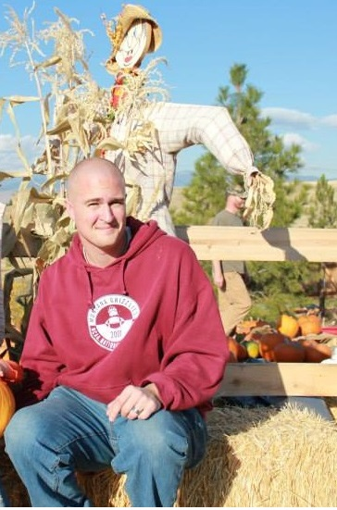
CPH
Garrett
Johnson
Physical Therapy

Slide 13
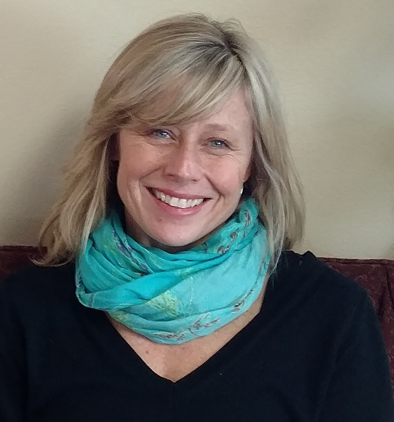
CPH
Beth
Jones

Slide 14
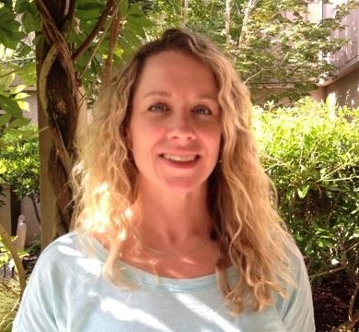
MPH
Vann
Lovett

Slide 15
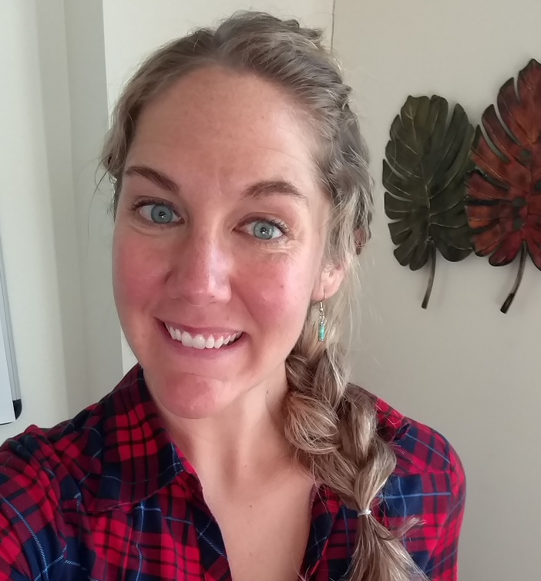
MPH
Jeanna
Miller

Slide 16
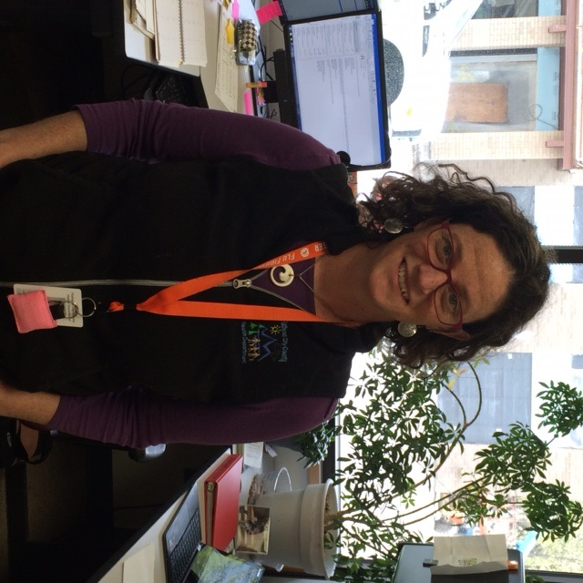
CPH
Heather
Murray

Slide 17
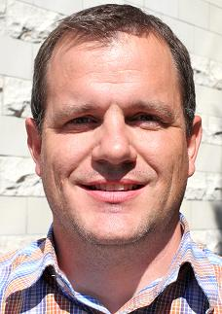
CPH
Carlton
Nelson

Slide 18
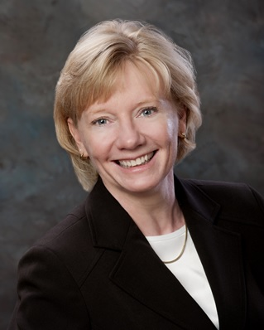
MPH
Kelly
Parsley

Slide 19

CPH
Elizabeth
Redinger
Health & Human Performance

Slide 20
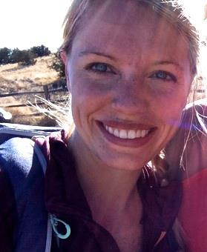
CPH
Jennifer
Schuberg

Slide 21
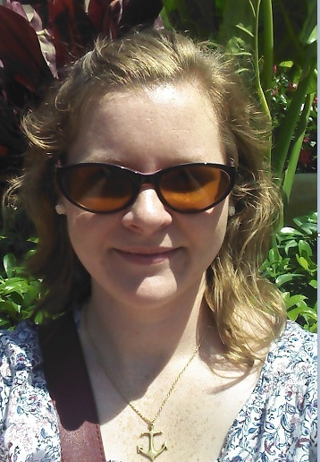
MPH
Lindsey
Shankle

Slide 22
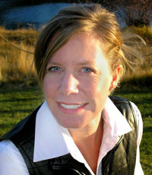
MPH
Linnea
Stanhope

Slide 23
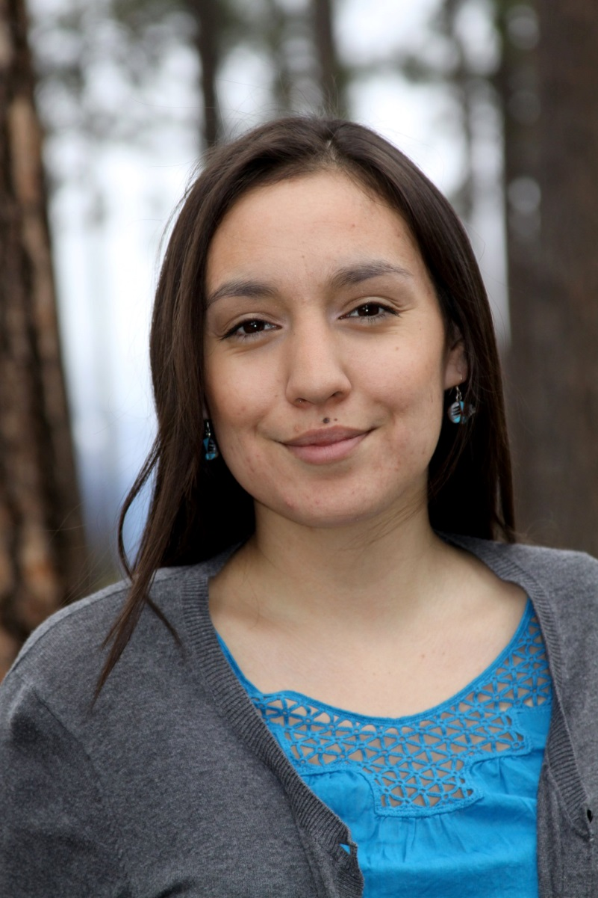
MPH
Amy
Tall Bull
(Stiffarm)

Slide 24
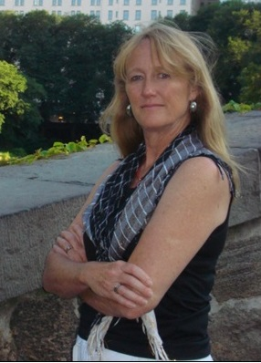
MPH
Pamela
Whitney

Slide 25
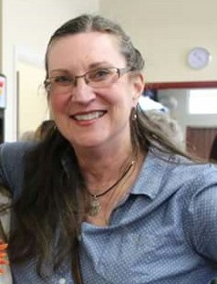
MPH
Winifred
Youngblood

